Slide 1
Chapter 9_2 Sound in medicine
Dr rafid albadr |

Slide 2
Reflection and transmission
Within a given medium the sound wave can be attenuated by absorption and scattering.
In scattering, part of the propagating beam is redirected into many directions, without being absorbed. Depand on roughness of the tissue or surface.
Attenuation refers to the reduction in the beam intensity with depth in tissue caused by absorption,
$$A\left(z\right)=A\left(z=0\right)e^{(−2γ_{sound}Fz)}$$
where 𝜸 sound is the absorption coefficient (attenuation coefficient) varies with a physical properties of conducting medium and frequency, and F is the frequency dependence. For pure liquids, F = f² in Hz² and for soft tissues,
the acoustic power or intensity varies as
$$I\left(z\right)=I\left(z=0\right)e^{(−2γ_{sound}Fz)}$$

Slide 3
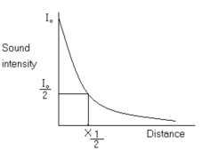
Reflection and transmission
$$I=I_{0}e^{(−2α x)}$$
$I_{0}$ is the incident intensity at x=0, and $I$ the intensity at depth x
The half – value layer(HVL)=X1/2 : is the thickness of absorbing tissue will reduce
the beam intensity to half it's original value (Io/2) , i.e
at X= X1/2 then I= Io /2:
$$x_{\frac{1}{2}}=\frac{0.693}{2α}$$

Slide 4
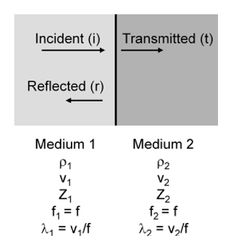
Reflection and transmission
The sound wave travels in medium 1 with intensity I_{i} and pressure P_{i} incident on the interface.
The part that is reflected back into the same medium has intensity I_{r} and pressure P_{r} ,
and the part that is transmitted into medium 2 has intensity I_{t} and pressure P_{t}.
The transmitted beam will leave the interface at an angle different from that of the incident beam. The deviation of the beam is called refraction

Slide 5
Reflection and transmission
The magnitudes of the pressures must match so there is no net force on the interface.
$P_{i}=P_{r}+P_{t}$

Slide 6
Reflection and transmission
And we get:
$\frac{P_{r}}{P_{i}}=\frac{Z_{2}−Z_{1}}{Z_{2}+Z_{1}}$
$\frac{P_{t}}{P_{i}}=\frac{{2Z}_{2}}{Z_{2}+Z_{1}}$
the fraction of intensity that is reflected is
the fraction of intensity that is transmitted is

Slide 7
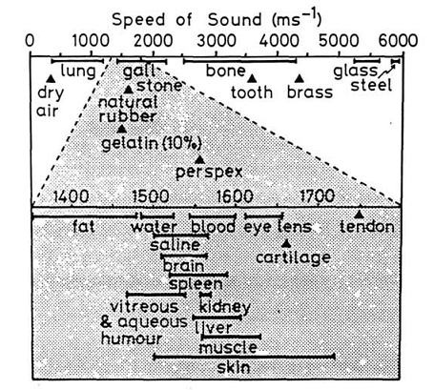
ULTRASOUND AS DIAGNOSTICAL TOOL
Ultrasound : It ranges above 20 kHz ,which is also cannot be heard.
The quality of ultrasound imaging is determined by the interaction of the acoustic wave with the body tissue
The two types of ultrasound employed in diagnostic are:
1. continuous wave
2. pulsed wave.
High frequency ultrasound results in better resolution than the low frequency.

Slide 8
ULTRASOUND AS DIAGNOSTICAL TOOL

Slide 9
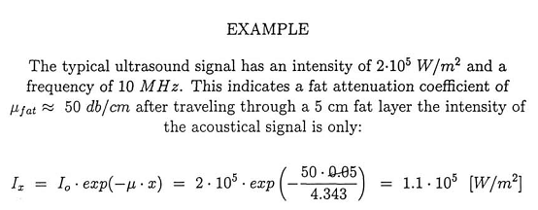
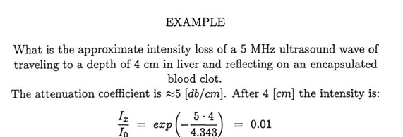
ULTRASOUND AS DIAGNOSTICAL TOOL

